Slide 1
Spring Framework

Slide 2
Spring
Introduction
Spring is an open-source framework created to address the complexity of enterprise application development
One of the chief advantages of the Spring framework is its layered architecture, which allows you to be selective about which of its components you use while also providing a cohesive framework for J2EE application development

Slide 3
Features
Lightweight
Spring is lightweight when it comes to size and transparency
The basic version of spring framework is around 1MB, and the processing overhead is also very negligible
Inversion of control (IOC)
The basic concept of the Dependency Injection or Inversion of Control is that programmer do not need to create the objects, instead just describe how it should be created
No need to directly connect your components and services together in program, instead just describe which services are needed by which components in a configuration file/xml file
The Spring IOC container is then responsible for binding it all up

Slide 4
Features
Aspect oriented (AOP)
Spring supports Aspect oriented programming
Aspect oriented programming refers to the programming paradigm which isolates secondary or supporting functions from the main program’s business logic
AOP is a promising technology for separating crosscutting concerns, something usually hard to do in object-oriented programming
The application’s modularity is increased in that way and its maintenance becomes significantly easier
Container
Spring contains and manages the life cycle and configuration of application objects

Slide 5
Features
MVC Framework
Spring comes with MVC web application framework, built on core Spring functionality.
This framework is highly configurable via strategy interfaces, and accommodates multiple view technologies like JSP, Velocity, Tiles, iText, and POI
But other frameworks can be easily used instead of Spring MVC Framework

Slide 6
Features
Transaction Management
Spring framework provides a generic abstraction layer for transaction management
This allows the developer to add the pluggable transaction managers and making it easy to demarcate transactions without dealing with low-level issues
JDBC Exception Handling
The JDBC abstraction layer of the Spring offers a meaningful exception hierarchy, which simplifies the error handling strategy
Spring provides best Integration services with Hibernate, JDO

Slide 7
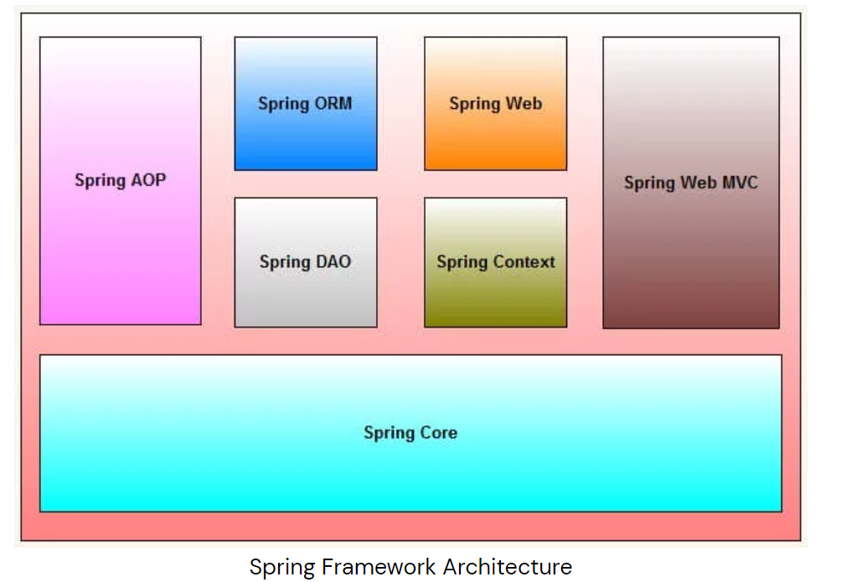
Architecture

Slide 8
Architecture
Spring is well-organized architecture consisting of seven modules. Modules in the Spring framework are:
Spring AOP (Aspect Oriented Programming)
Spring ORM (Object Relational Mapping)
Spring Web
Spring DAO (Data Access Object)
Spring Context
Spring Web MVC
Spring Core

Slide 9
Architecture
Spring AOP
To provide declarative enterprise services, especially as a replacement for EJB (Enterprise Java Beans) declarative services. The most important such service is declarative transaction management, which builds on Spring’s transaction abstraction.
To allow users to implement custom aspects, complementing their use of OOP with AOP

Slide 10
Architecture
Spring ORM
The ORM package is related to the database access. It provides integration layers for popular object-relational mapping APIs, including JDO (Java Data Objects), Hibernate and iBatis.
Spring Web
The Spring Web module is part of Spring’s web application development stack, which includes Spring MVC.

Slide 11
Architecture
Spring DAO
The DAO (Data Access Object) support in Spring is primarily for standardizing the data access work using the technologies like JDBC, Hibernate or JDO.
Spring Context
This package builds on the beans package to add support for message sources and for the Observer design pattern, and the ability for application objects to obtain resources using a consistent API.

Slide 12
Architecture
Spring Core
The Core package is the most import component of the Spring Framework.
This component provides the Dependency Injection features.
The ApplicationContext Factory provides a factory pattern which separates the dependencies like initialization, creation and access of the objects from your actual program logic.

Slide 13
Architecture
Spring Web MVC
Spring MVC framework is a robust Model view controller framework which helps us to develop a loosely coupled web application.
It separates different aspects of web applications with the help of MVC architecture.

Slide 14
Architecture
Spring Web MVC
Model: Model carries application data. It generally includes POJO (Plain Old Java Object) in the form of business objects.
View: View is used to render User interface (UI). It will render application data on UI.
Controller: Controller takes care of processing user request and calling back-end services.

Slide 15
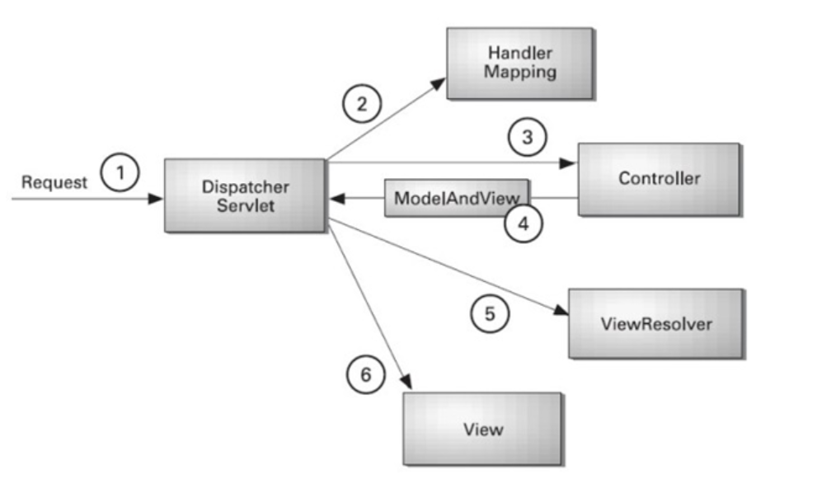
Spring MVC workflow

Slide 16
Spring MVC Workflow
As displayed in previous slide, all the incoming request is intercepted by the DispatcherServlet that works as the front controller.
The DispatcherServlet gets an entry of handler mapping from the XML file and forwards the request to the controller.
The controller returns an object of ModelAndView.
The DispatcherServlet checks the entry of view resolver in the XML file and invokes the specified view component.

Slide 17
Spring Framework
The End

